Slide 1
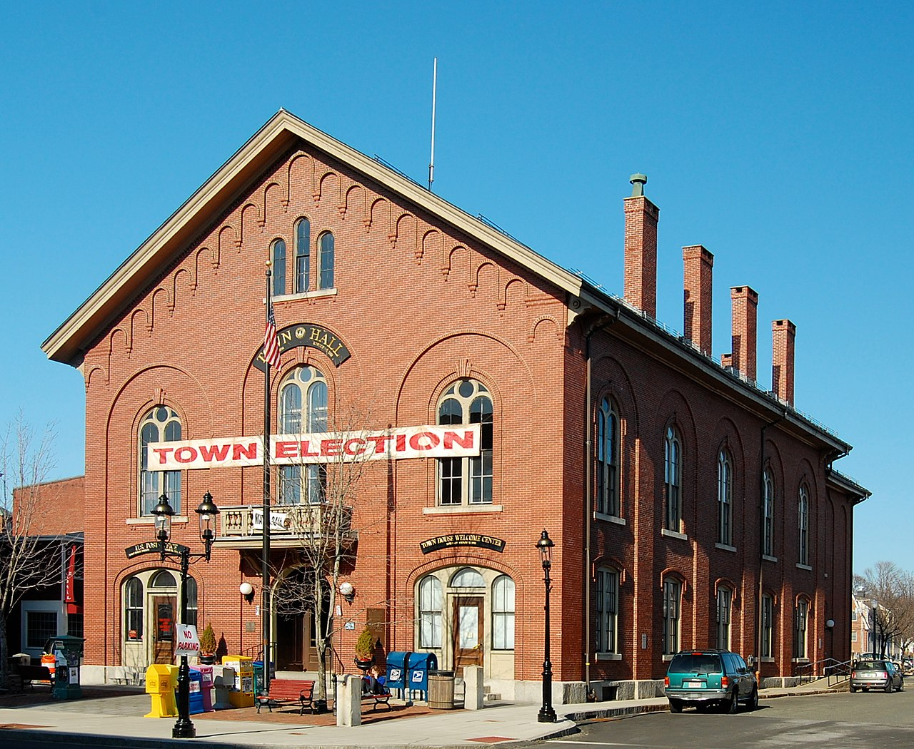
Andover Governing Structure: An Overview Andover Legal Department
7.17.2024

Slide 2
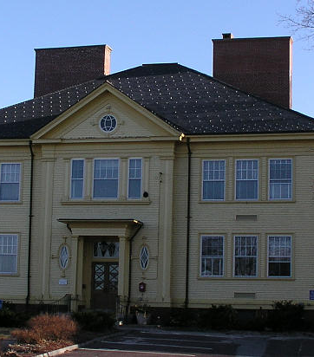
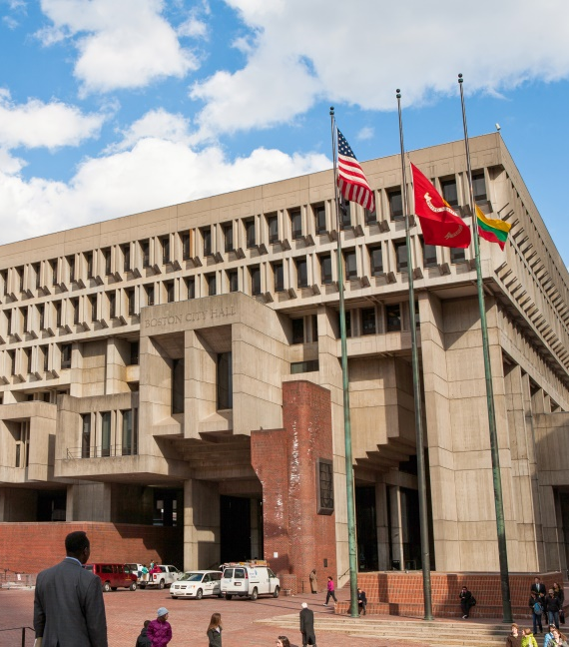
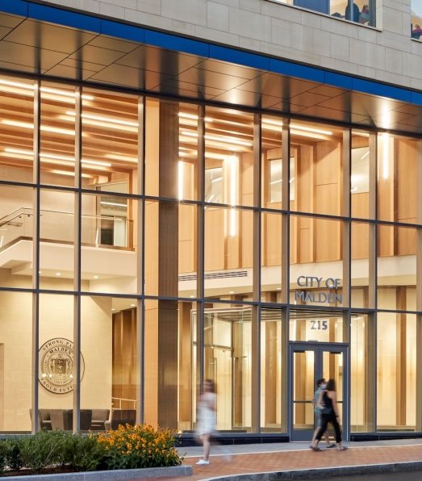
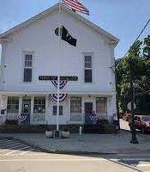
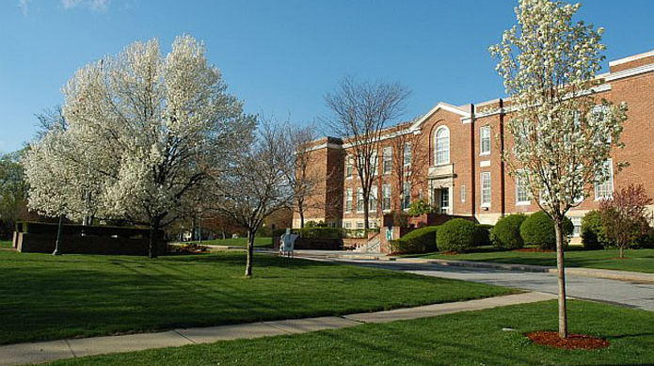
The Municipal Corporation
All 351 Towns & Cities of MA are subdivisions of the Commonwealth
292 Towns
59 Cities
Town vs. City is a function of organization (and identity)
Largest Town = Brookline (pop. 63,000+)
Smallest Town = Gosnold (pop. 115)
Largest City = Boston (pop. 675,000+)
Smallest City = Palmer (pop. 12,488)

Slide 3

Sources of Authority to Organize
Prior to 1996 Home Rule Amendment
Few options dictated by rigid State Law
After the Home Rule Amendment
In 1966, Art. 89 of the Massachusetts Constitution provided:
An affirmation of the right of towns and cities to self-govern locally
A Charter process which was not contingent on subsequent state approval, later codified as the Home Rule Procedures Act. – Chapter 43B, and…
A significant list of limitations on self-governance, restraining municipalities from enacting laws which:
Preemption***
Regulate elections
Borrow money or pledge credit
Levy, assess and collect taxes
Dispose of park land
Private or civil laws governing civil relationships (with some exceptions)
Provide for felony offenses or imprisonment for violations of local laws

Slide 4
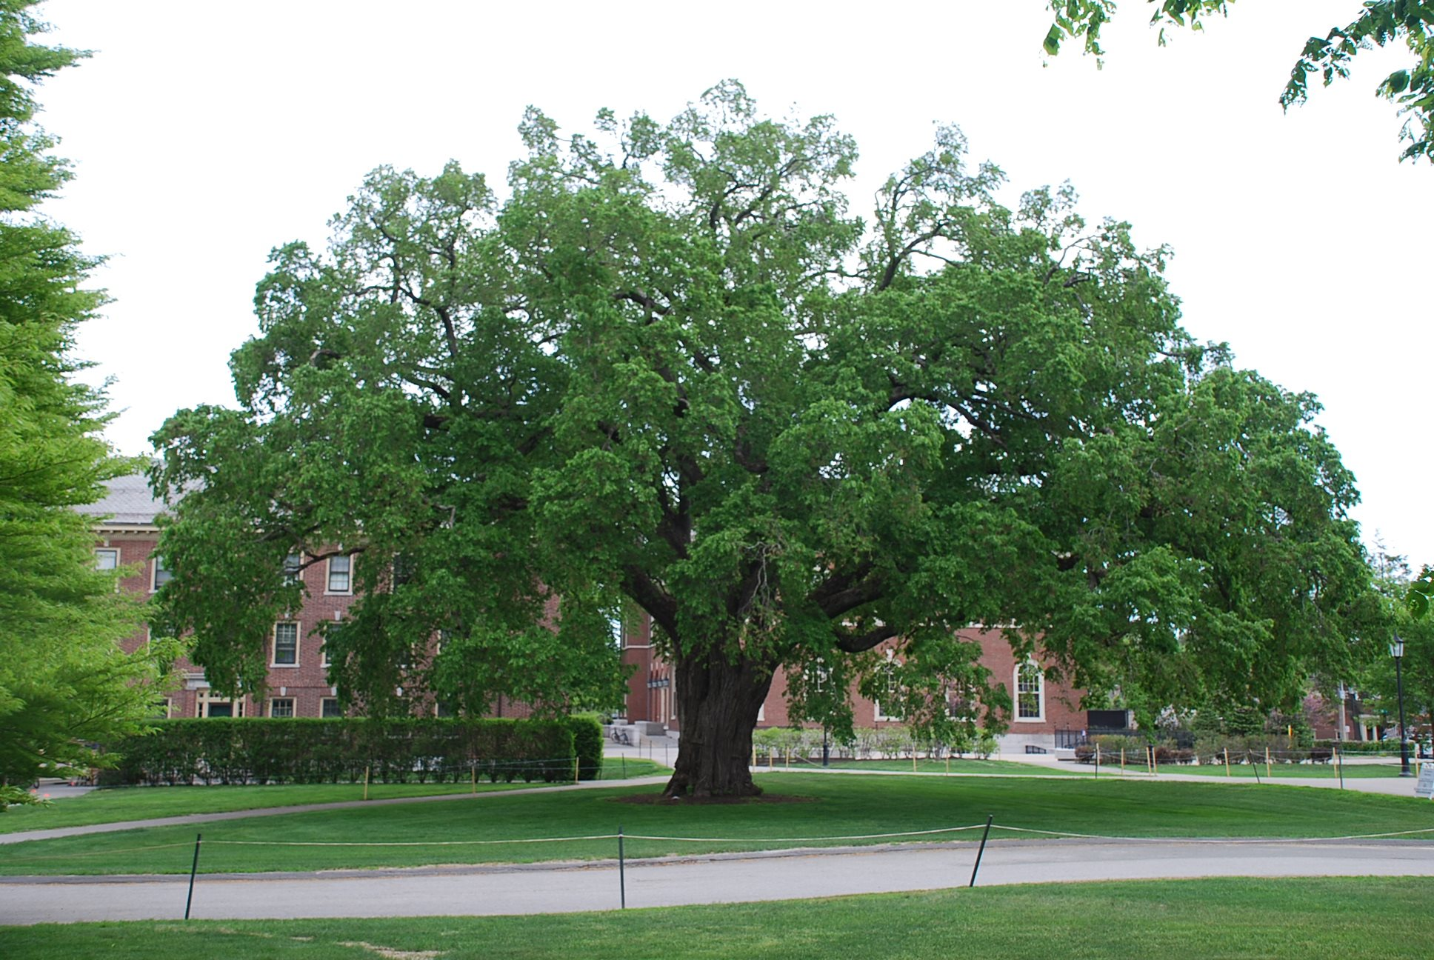
Municipal Corporation Features
Town Governance Features
Executive:
Elected Select Board
Elected School Committee
Appointed Town Manager/Administrator/Executive Secretary
Appointed Superintendent
Legislature
Elected Moderator
Either Open or Elected Representative Town Meeting
City Governance Features
Executive:
Elected Mayor/ Appointed Manager
Elected/Appointed School Committee
Appointed Superintendent
Legislature
City Council
*NB: A Select Board & City Council do not occupy the same role.

Slide 5
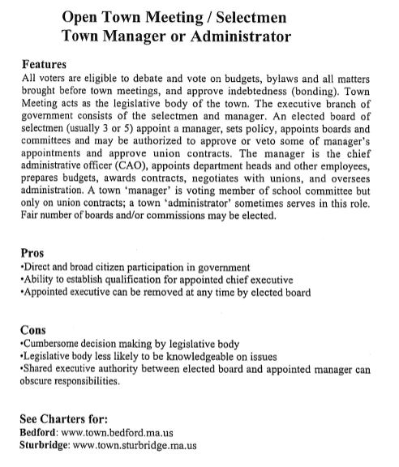
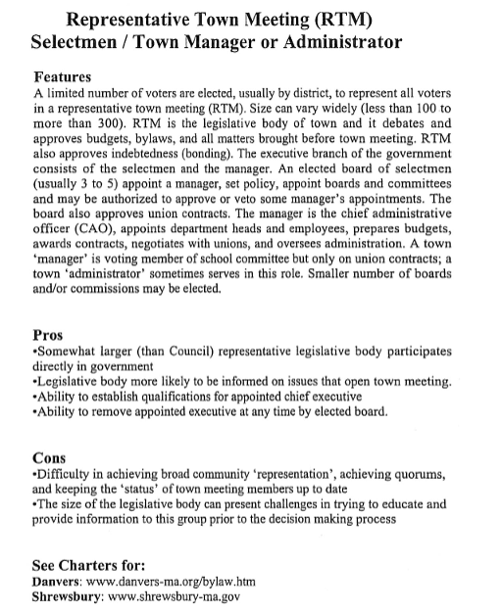
Pros & Cons from Municipal Elected & Appointed Officials: Towns
Credit: “Forms of Local Government Commonwealth of Massachusetts,” MMA Form of Governance Committee

Slide 6
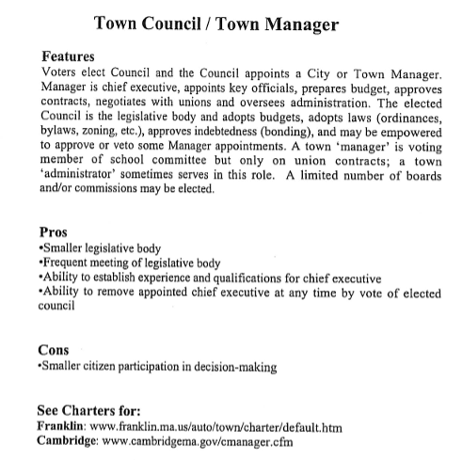
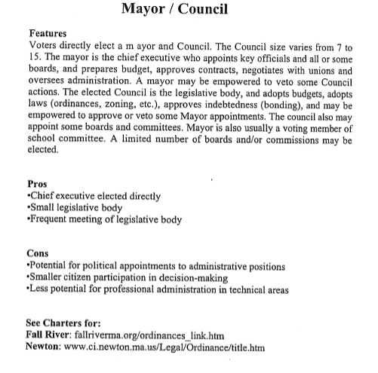
Pros & Cons from Municipal Elected & Appointed Officials: Cities
Credit: “Forms of Local Government Commonwealth of Massachusetts,” MMA Form of Governance Committee

Slide 7

Municipal Governance Trends & the Law
Customization
Professionalization
Centralized Management & Delegation of Authorities
Increased Complexity
Mandates
Budgeting
Post-War Population & Services
Transparency of Public Bodies

Slide 8
Municipal Governance Trends & the Law
Increased Complexity
Mandates
Budgeting
Post-War Population & Services
Transparency of Public Bodies
Pathways for Towns & Cities
Conversion to Plan “Cities”
Delegation to Town Administrators & Executive Secretaries by c. 41 sec. 23A
Special Act Charters and c. 43B Charters, including Town and City Professional Managers

Slide 9
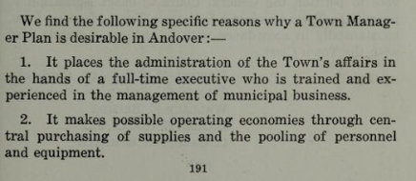
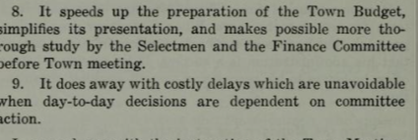
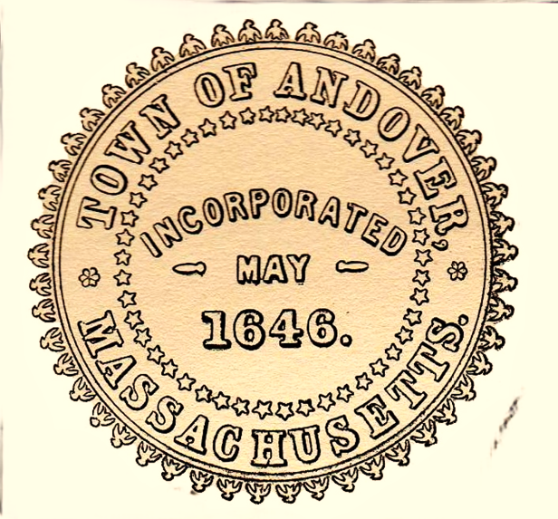
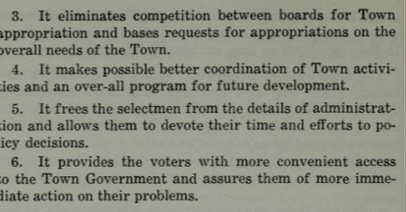
Andover’s Charter: 1955 Annual Report & The Select Board-Manager Plan

Slide 10

Andover’s Charter
Special Act Charter: Chapter 571 of the Acts of 1956
Revised 6 Times by Subsequent Special Acts
Shared but Centralized Executive Authority:
Maintained the Open Town Meeting form of government, but with a “Strong Manager” Chief Officer
4 Executive entities: Select Board, School Committee, Town Manager and Superintendent
CEO/Board of Directors/Shareholder analogy
Similar “Strong Manager” design to Lexington, Needham, Belmont, Danvers, Arlington, Winchester, North Andover (and still are).

Slide 11
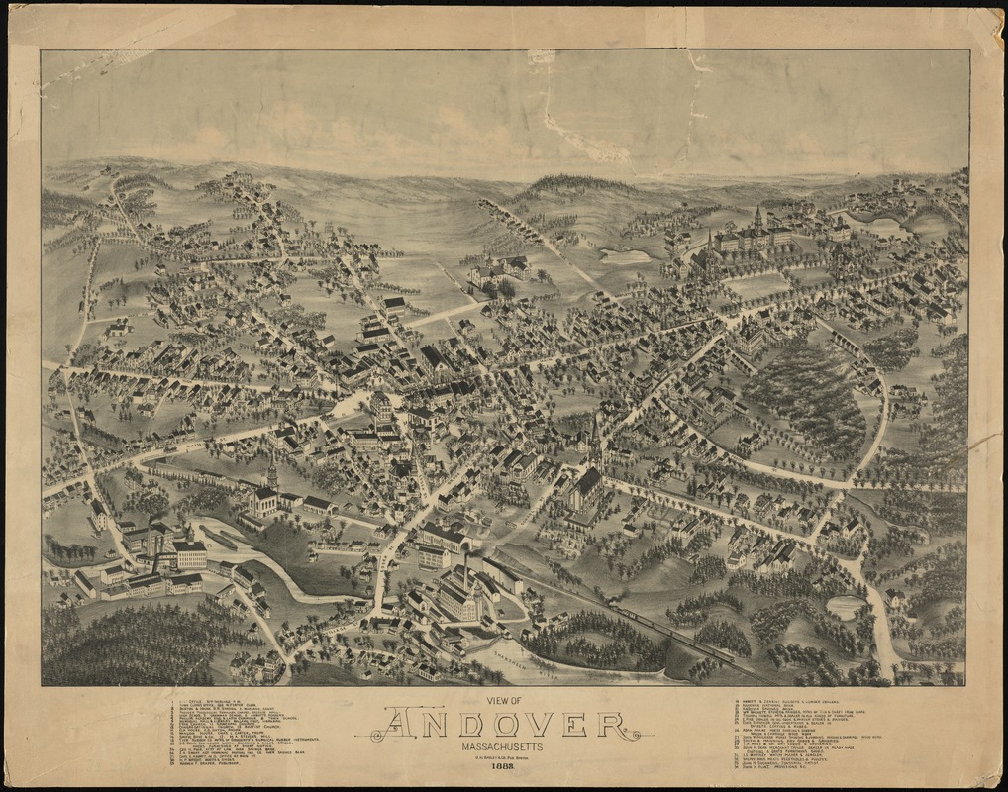
Select Board’s Role & Responsibilities
Dictated by the General Laws and the Town Charter
Prepare and issue the Town Meeting warrant and call Town Meetings
Appoint and evaluate, and negotiate the terms of the contract with the Town Manager
Appoint the Town Accountant, the Zoning Board of Appeals, the Registrars of Voters, and remove same for cause
Approve certain appointments by the Town Manager
Conduct hearings and grant licenses and permits
Review budget recommendations before they go before the Town Meeting
Place any Proposition 2½ question on the local ballot
Policymaking & Rate Setting:
Goals and priorities
Tax Rate
Water Rate *
Disposing of (most) Town real property (with Town Meeting)
Local regulations related to permits and hearings
Good practice: refrain from engaging in “operations”
Parking & Traffic Rules

Slide 12
Town Manager Role & Responsibilities
Supervise and direct offices, agencies boards and committees appointed by Manager
Organize, establish and abolish departments, commissions, boards or offices under supervision,
Affix compensation of all town officers and employees appointed by Manager
Keep full and complete records and provide them to the Select Board as Requested
Apprise the Board of the needs of the Town and make recommendations for Board action within Board purview
Manage rental and use of all town property, except schools, including maintenance and repair
Administer provisions of general and special laws, town, bylaws and all regulations of the Select Board except where administration is delegated by law to another authority
With the approval of the Select Board, prosecute, defend or compromise all litigation to which the town is a party.
Other duties consistent with his office as may be required of him by the by-laws or vote of the town or by the vote of the select board
Authorized to investigate all departments and employees with full access to records
Purchase all supplies, materials and equipment except library and schools, and serve as contracting authority
Plus….

Slide 13
Town Manager Role & Responsibilities
Approve (payment) Warrants
Submit a budget to the Select Board and Finance Committee
Serve as Chief Fiscal Officer for the Town.
-Per the Town Bylaws

Slide 14
Town Meeting Responsibilities
Serves as the Legislative Body
Approve/Amend Zoning and Town Bylaws*
Authorize Borrowing and Debt*
Approves the Town & School Budget
Adopts Local Options, Including L.O. Taxes
Authorizes Certain Agreements/Amendments to Agreements
Approves and Requests Special Legislation and Changes to the Andover Charter

Slide 15
Separation with Schools
Under Andover’s Model (and most models)
Administration of Schools is largely independent
Similar relationship between School Committee & Superintendent
Similar relationship to Town Meeting

Slide 16


Notes on Town Executive Authority
Diffused into 4 Executives (2 Town and 2 School), and
Shares Responsibility and Oversight with Other Town Entities – FinCom, Planning Board, etc.
Balances Professionalization with Democratic Representation
Group Decision-making and Consensus Building by Part-Time Elected Officials with the Efficiency of an empowered full-time professional Manager
Town Manager
Select Board

Slide 17
Acknowledgements
Forms of Local Government Commonwealth of Massachusetts, Massachusetts Municipal Management Association, Form of Governance Committee
Marilyn Contreras, Several Options Exist for Changing Local Government Structures, Municipal Advocate Vol. 22, No. 2
Local Charter Procedures Election Resource Handbook 1995 (Massachusetts Secretary of State William Galvin)
1955 Report of the Town Governance Study Committee to the Annual Town Meeting.
David J. Barron, Gerald E. Frug & Rick Su, Dispelling the Myth of Home Rule: Local Power in Greater Boston (Rappaport Institute for Greater Boston 2004)
Local Government 101 https://www.mma.org/local-government-101/

Slide 18

Questions & Discussion

