Slide 1
MBTA Communities Multi-family zoning
Planning Board – March 6, 2024
Community development & Planning

Slide 2
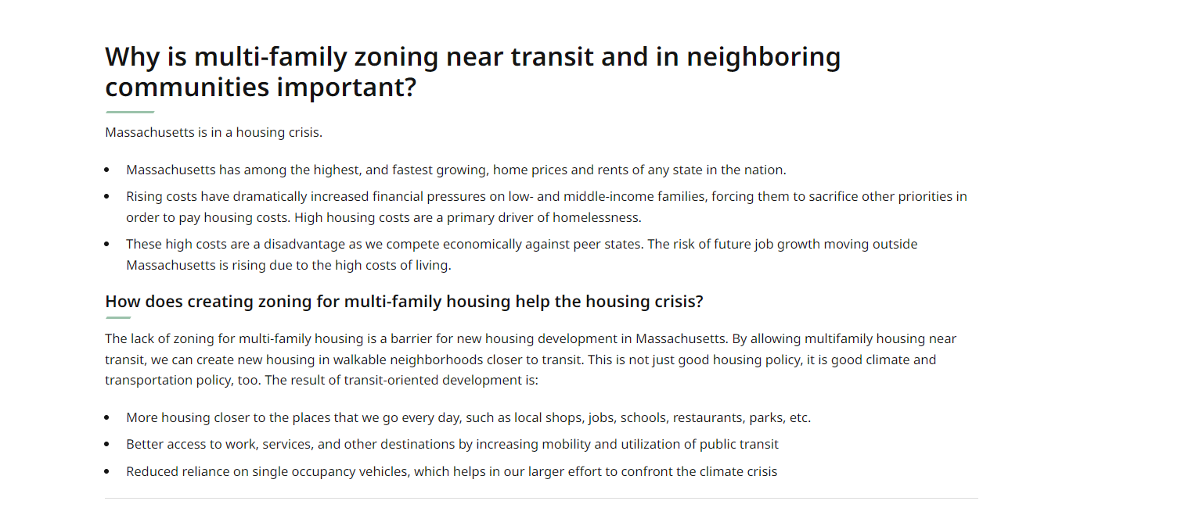
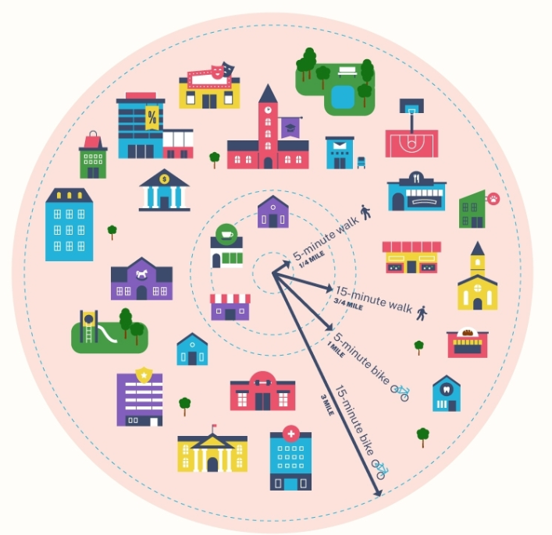
Reason for the Law
Credit: movebuddha.com

Slide 3

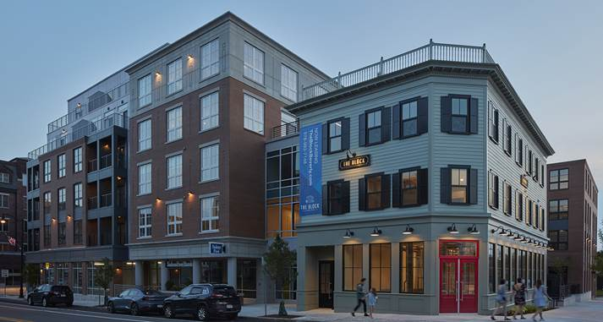



What does this mean for Andover?
Environmental Benefits
Reduce dependence of automobiles
Reduce Greenhouse Gas Emissions
Reduce Sprawl
Housing Benefits
Economic Benefits
Variety of Housing Options
Provide housing options to workers
Allow people to age in place.
Higher, stable property values
Increased foot traffic
Vibrate places were people want to be
Source: SV Design | The Block at Odell Park
Health Benefits
Reduce Isolation
lower frequency of traffic casualties
promote physical activity and reduce chronic disease.

Slide 4
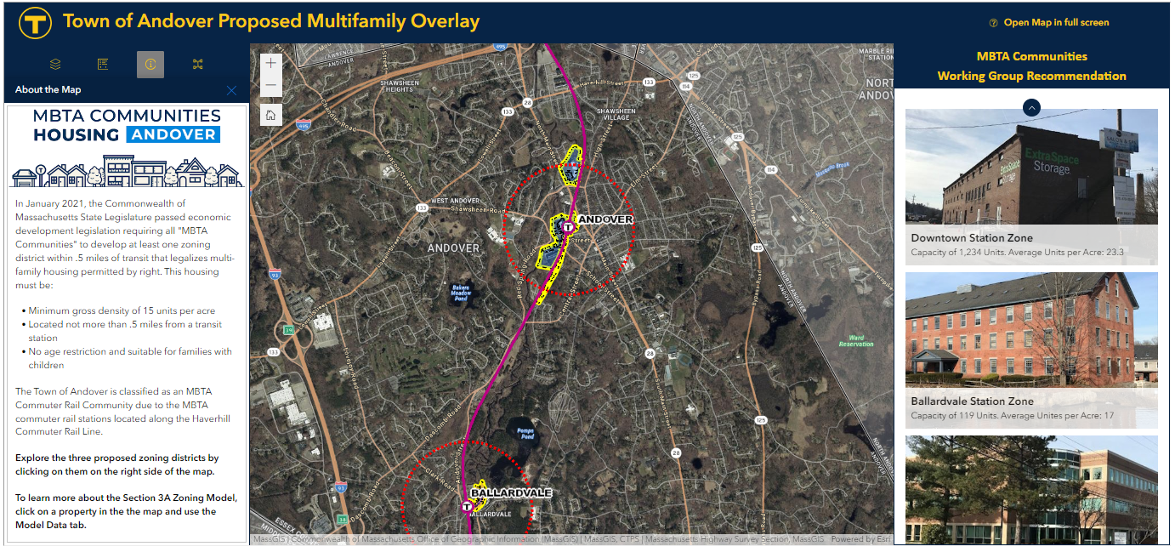
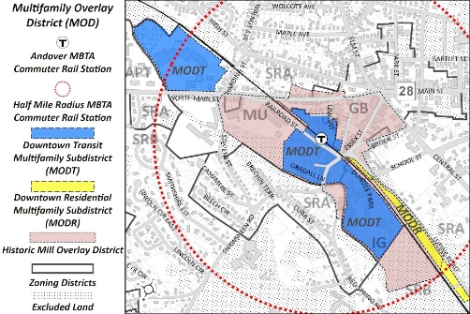
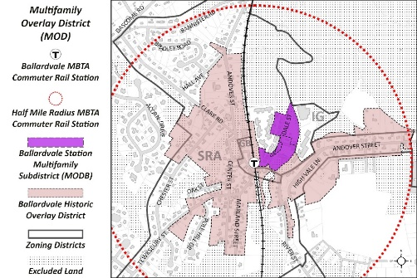
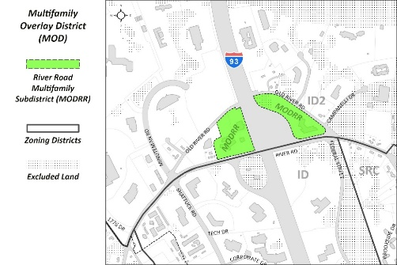
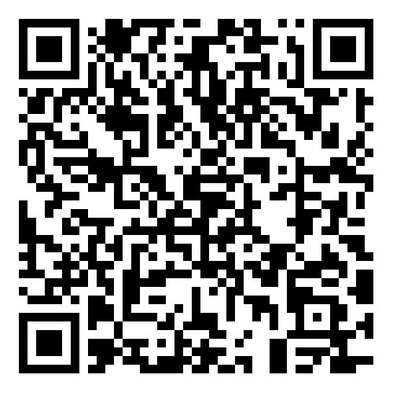
District Locations
Explore the three proposed zoning districts
Learn more about the individual properties included in the proposed zone
View transit stops
Review the current property densities.
See Unit Capacity at the parcel level
andoverma.gov/mbtacommunitiesmap

Slide 5
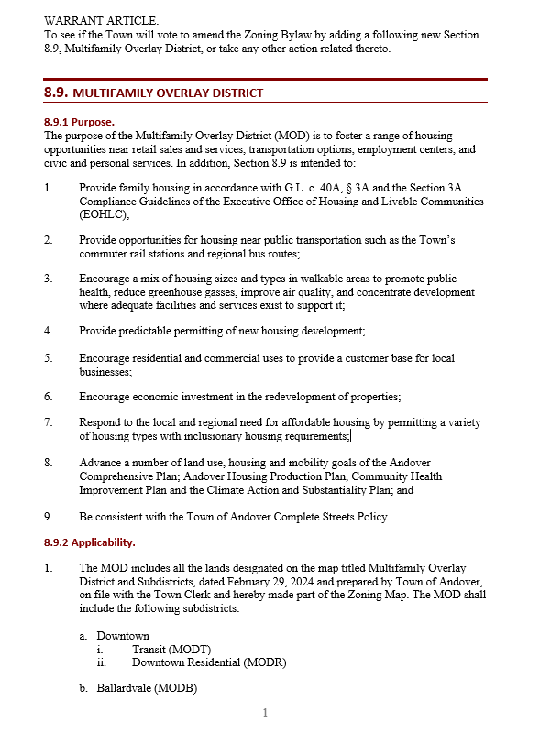
Draft zoning
Revised – March 5, 2024
Multi-Family Overlay District (MOD)
https://andoverma.gov/DocumentCenter/View/14139

Slide 6
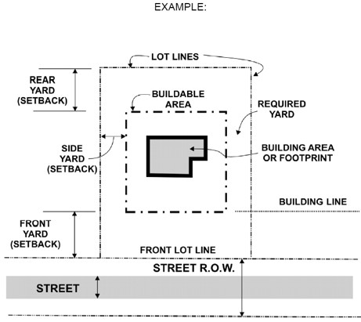
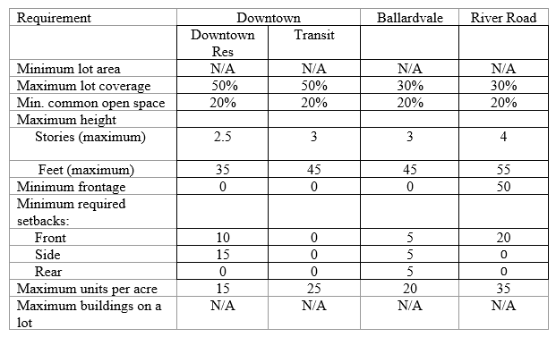
Draft zoning
Revised – February 29, 2024

Slide 7
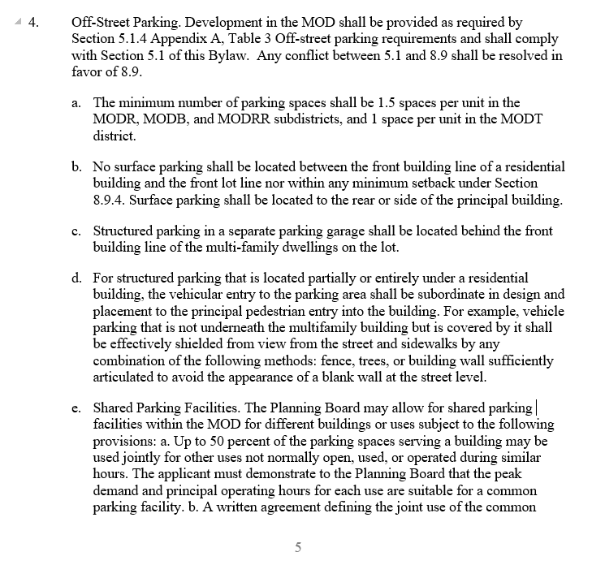
Draft zoning
Revised – February 29, 2024

Slide 8
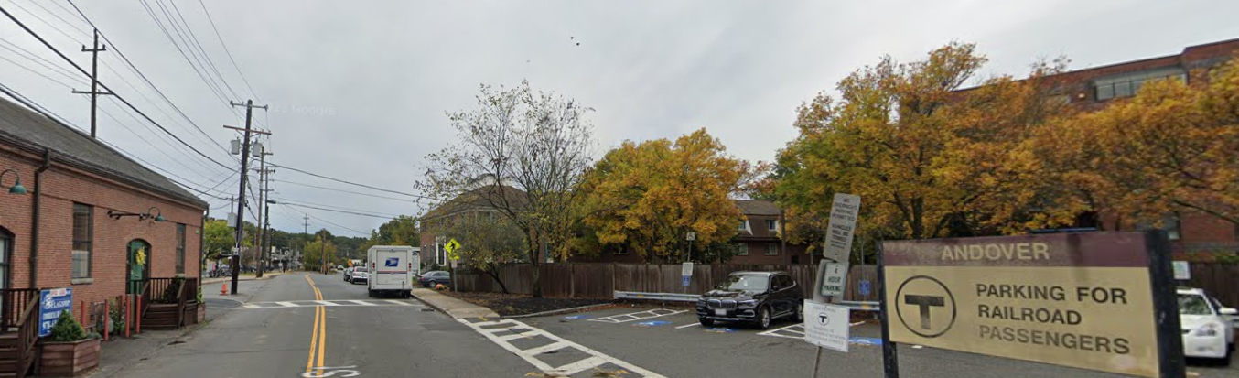
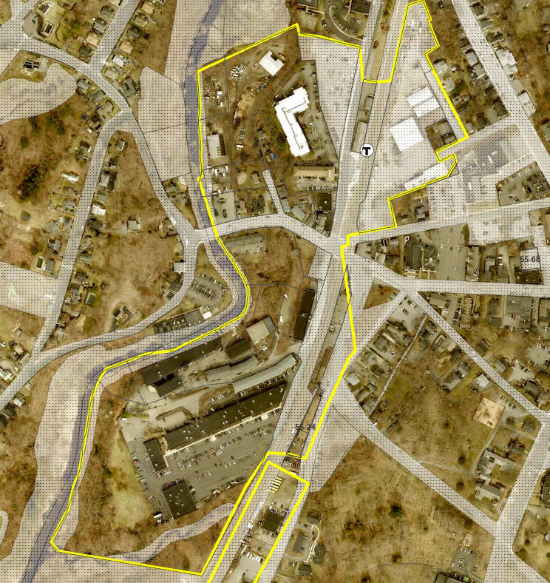
Downtown Transit
Dimensional Table
Criteria | General Business | Historic Mill Overlay District | Industrial G | Mixed Use | Proposed
Minimum Lot Area | _ | .5 acre | _ | _ | _
Maximum Lot Coverage | _ | 75% | _ |  | 50%
Min. common open space | _ | _ | _ | _ | 20%
Maximum height
Stories (maximum) | 4 |  | 5 | 4 | 3
Feet (maximum) | 50 | 50 | 60 | 50 | 55
Minimum frontage | _ | _ | _ | 50 | 0
Required setbacks:
Front (min) | _ | _ | 30 | 10 | 0
Side | _ | _ | 15 | 10 | 0
Rear | _ | _ | 15 | 10 | 0

Slide 9
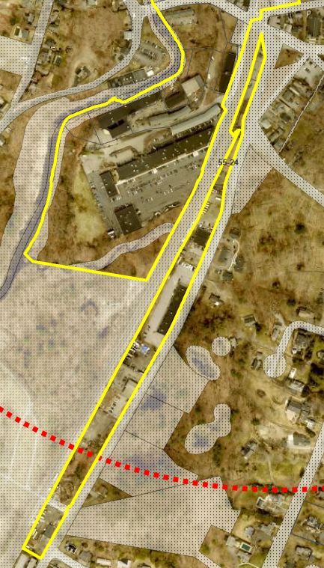
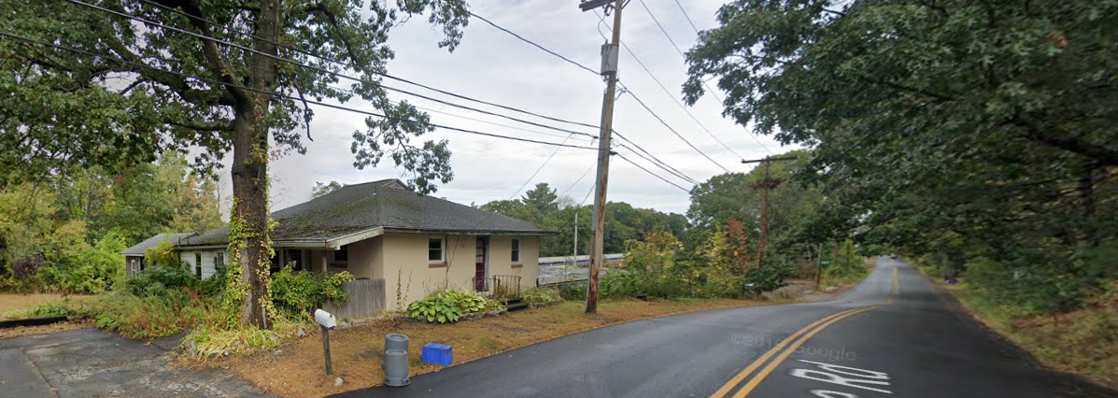
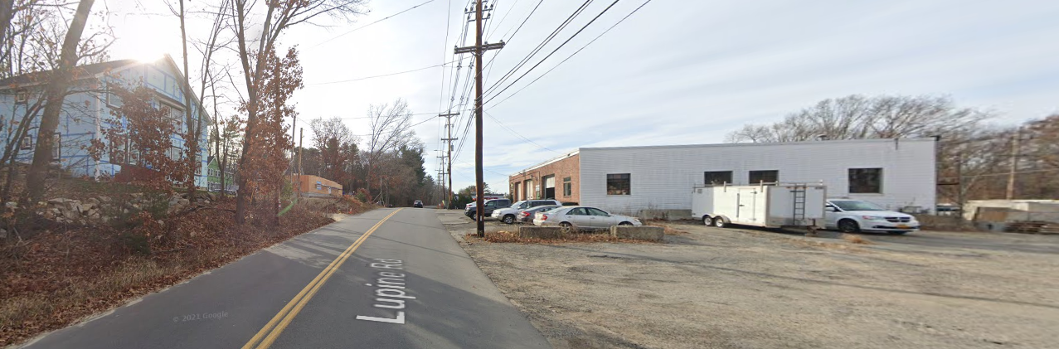
Downtown Residential
Dimensional Table
Criteria | Industrial G | Proposed
Minimum Lot Area | _ | _
Maximum Lot Coverage |  | 50%
Min. common open space | _ | 20%
Maximum height
Stories (maximum) | 5 | 2.5
Feet (maximum) | 60 | 35
Minimum frontage | _ | 0
Required setbacks:
Front (min) | 30 | 10
Side | 15 | 15
Rear | 15 | 0

Slide 10
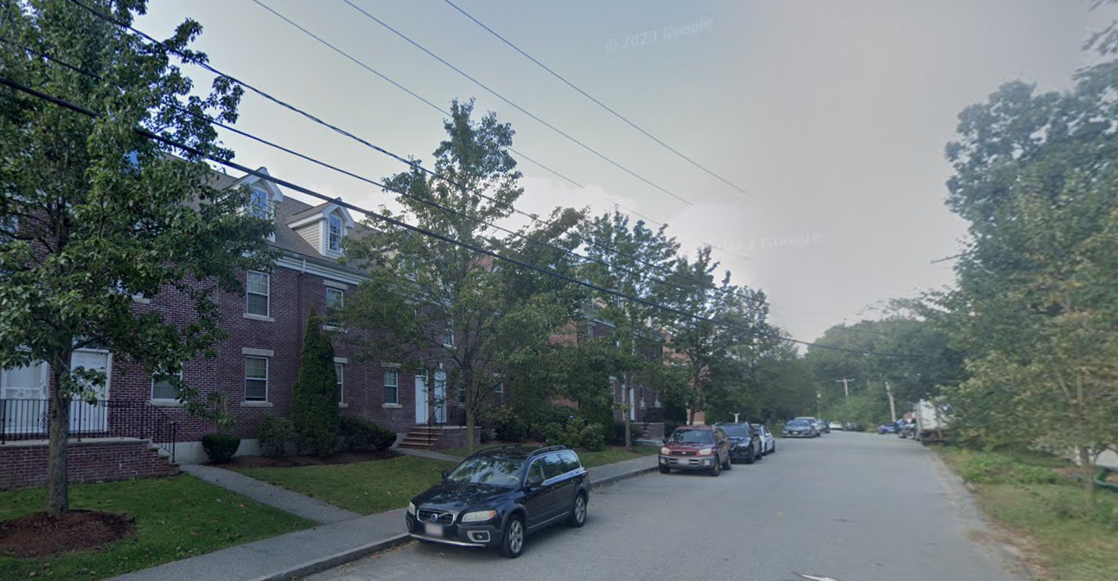
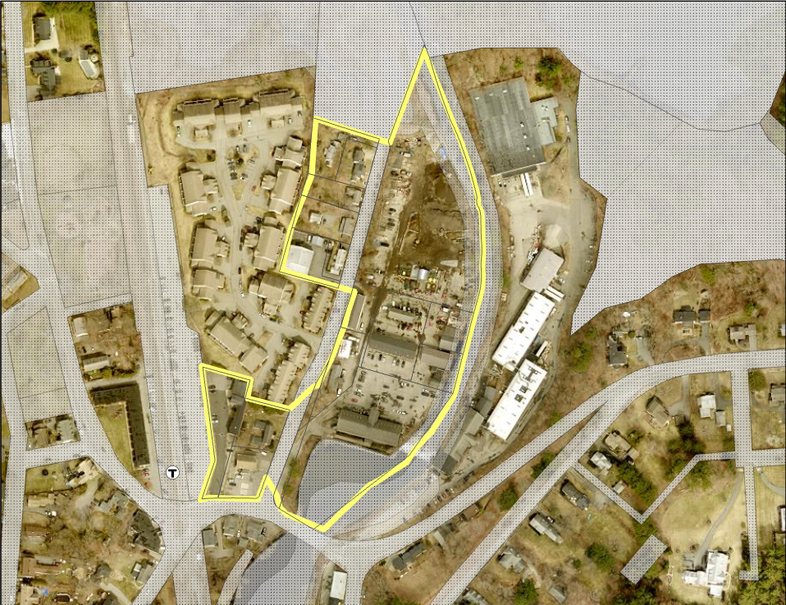
Ballardvale
Dimensional Table
Criteria | Industrial G | Proposed
Minimum Lot Area | _ | _
Maximum Lot Coverage |  | 30%
Min. common open space | _ | 20%
Maximum height | 60 | 45
Stories (maximum) | 5 | 3
Feet (maximum) | 60 | 45
Minimum frontage | _ | 0
Required setbacks:
Front (min) | 30 | 0
Side | 15 | 0
Rear | 15 | 0

Slide 11
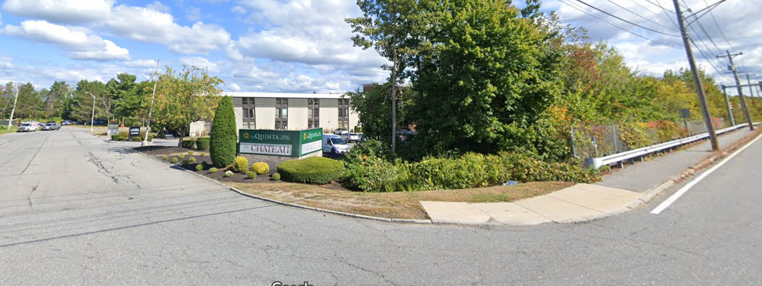
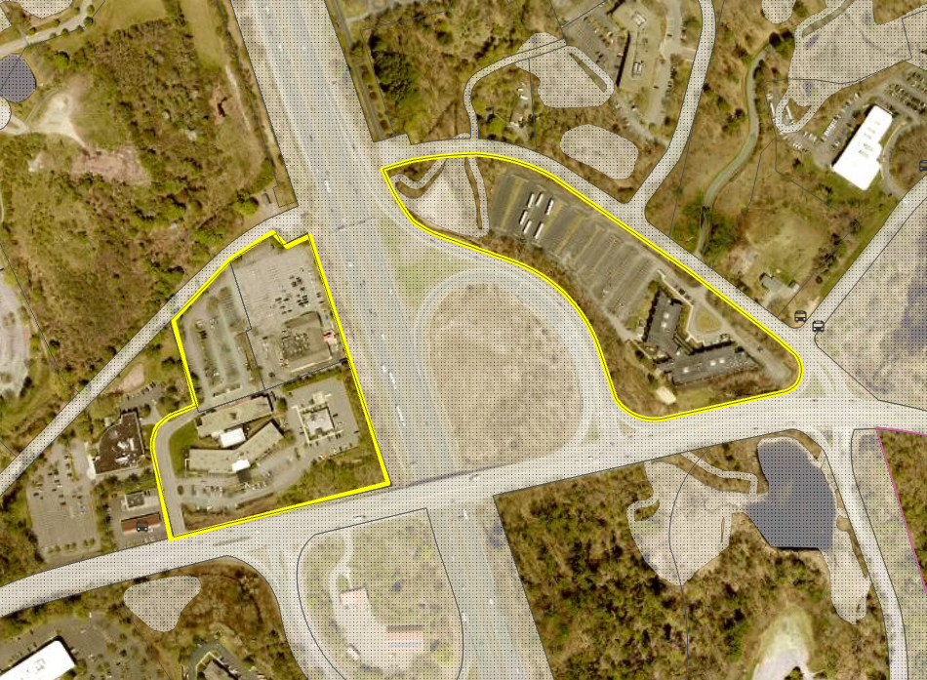
River Road
Dimensional Table
Criteria | Industrial D2 | Proposed
Minimum Lot Area | _
Maximum Lot Coverage | _ | 30%
Min. common open space | _
Maximum height
Stories (maximum) | 4 | 4
Feet (maximum) | 50 | 55
Minimum frontage | 50 | 50
Required setbacks:
Front (min) | 50 | 20
Side | 40 | 0
Rear | 40 | 0

Slide 12
Submission Requirements
The proposed placement of buildings;
Major topographical changes;
Surface and ground water drainage and erosion control;
Protection against flooding and inundation;
Prevention of water and pollution and environmental damage;
Provision for adequate utility services;
Provisions for off-street parking and loading;
Location of intersections of driveways and streets;
The effect of additional traffic created by the development on intersections and streets likely to be affected by the proposed development;
Provision for pedestrian/bicycle accessways connecting to adjacent open space, neighborhoods, schools, recreation areas or transportation facilities and for alternative transit programs;
Provisions for landscaping and adequate screening and buffering.
The Planning Board may approve the site plan only if it determines that the proposed development meets the intent and provisions of the Zoning Bylaw and will not result in detriment to the town or the neighborhood in which it is located.

Slide 13
Community Engagement
Date | Event | Date | Event | Date | Event
4/25/2022 | MBTA Communities Zoning Presentation to the Select Board | 5/24/23 | Published in Andover Dispatch | 11/15/2023 | Library Pop up
8/10/22 | DHCD (now EOHLC) issued the final guidelines to determine compliance. | 6/7/23 | Community Conversation Visioning Session 1 | 11/29/2023 | AGAB Update
9/9/22 | Housing Coalition Meeting | 6/21/23 | MBTA Communities Working Group Announced | 12/12/2023 | Historic Commission Update
11/23/22 | DHCD (now EOHLC) Released Compliance Model | 8/18/23 | Library Pop up | 12/12/2023 | Planning Board Update
11/29/22 | There is Something About Andover | 8/31/23 | Library Pop up | 12/16/2023 | Ballardvale Site Walk
11/15/22 | MBTA Communities Zoning Presentation of the Planning Board | 8/31/23 | Published in Andover Dispatch | 1/05/2024 | Rotary Update
1/31/23 | Action Plan Submitted to DHCD (now EOHLC) | 9/7/23 | Library Pop up | 1/09/2024 | Planning Board Update
4/26/23 | Coffee With A Planner (Robb Center) | 9/13/23 | Robb Center Health Fair | 1/22/2024 | Select Board
4/19/23 | Andover Preservation Committee | 9/15/23 | Town wide PTO | 2/13/2024 | Planning Board
1/6/23 | DEI Commission | 9/22/23 | Rotary Club | 2/27/2024 | Planning Board
1/25/23 | Coffee With A Planner | 9/30/23 | Andover Days | 2/28/2024 | Andover Green Advisory Board
2/13/23 | Select Board | 10/6/23 | MBTA Communities Focus Group | 3/06/2024 | Planning Board
3/1/23 | MBTA Community Conversation | 10/10/23 | DEI Commission | 3/13/2024 | Coffee with a Planner
Monthly Updates | EDC | 10/10/23 | Preservation Commission | 3/20/2024 | Coffee with a Planner
10/26/22 | Disability Commission | 10/12/23 | Community Conversation: Community Update | 3/27/2024 | Coffee with a Planner
3/1/23 | Community Conversation: Intro to MBTA Communities Law | 10/26/23 | Halloween Tabling | 4/3/2024 | Coffee with a Planner
4/26/23 | Robb Center Coffee With a Planner | 11/1/23 | Library pop up | 4/10/2024 | Coffee with a Planner
4/19/23 | Preservation Commission & Ballardvale Historic District Commission | 11/8/23 | Library pop up
4/25/23 | Susan McCready - School Committee Rep | 11/14/23 | Planning Board Update

Slide 14
Next Steps
Planning Board Review of Draft – March 12, 2024
Planning Board Hearings Open – March 19, 2024
Town Meeting – April 29, 2024

Slide 15

Questions
Community Development & Planning
(978) 623-8650
CDPPlanningEconomic@andoverma.us
For more information:
Andoverma.gov/MBTAzoning

